Slide 1
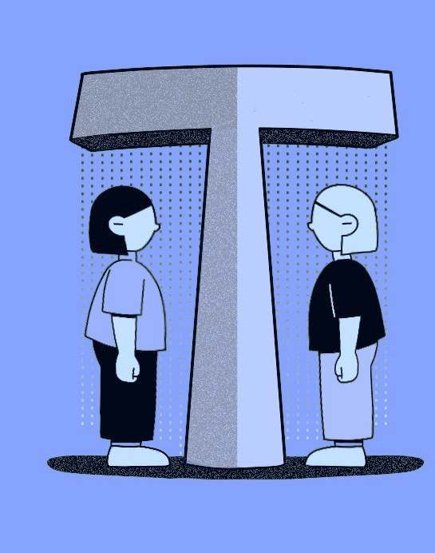
T-TEST
Dr. Srinibash Dash
Associate Professor & Head
School of Management
Gangadhar Meher University
)

Slide 2
CONTENTS
INTRODUCTION TO T-TEST
OBJECTIVE OF T-TEST
ASSUMPTIONS
APPLICATION OF T-TEST
TYPES OF T-TEST
PAIRED SAMPLE T-TEST
ONE SAMPLE T-TEST
INDEPENDENT T-TEST
CONCLUSION

Slide 3
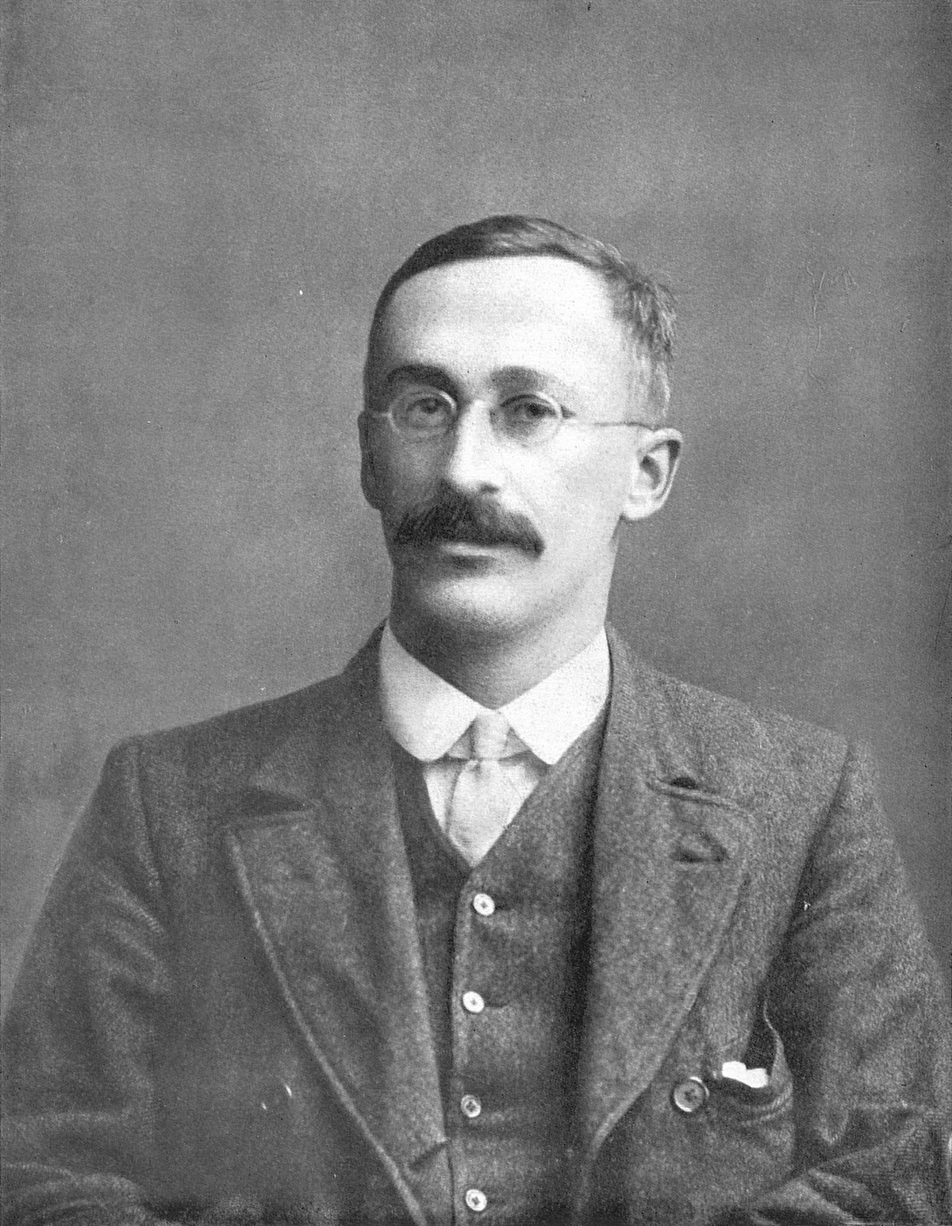
-:INTRODUCTION:-
T-test was introduced in 1908 by William Sealy Gosset.
The technique that is used to compare 2 groups is called t-test.
Using t-test we find out the significant difference between the means of 2 group.

Slide 4
-:oBJECTIVE OF T-TEST:-
The purpose of this test is to determine if there is significant difference between the means of two groups and how they are related.
Basic hypotheses:
Null – The difference in group mean is zero.
Alternative – The difference in the group means is different from zero.

Slide 5
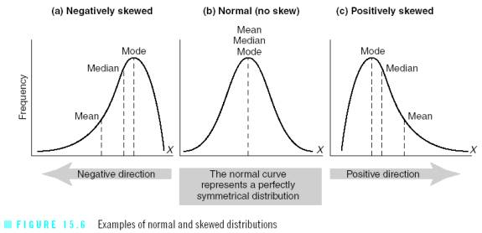
-:assumptions:-
Scale of measurement – The scale of measurement applied
to the data collected follows a continuous or ordinal scale.
Random sampling - Sample are randomly selected.
assumption of normality – The sample mean is normally
distributed.
assumption of homogeneity of variance – Equal variance between
groups is called as homogeneity of variance.

Slide 6
-:Application of t-test:-
To compare the mean of a sample with population mean (or known mean value).
To compare the mean of one sample with the mean of another independent sample.
To compare between the values (readings)of one sample but in 2 occasion.
To determine the confidence interval for a sample mean.

Slide 7
-:TypeS of t-test:-
There are 3 types of t-test:
One sample t-test:- It has only one sample. It is used to compare a single sample with a population value.
Independent sample t-test:- It is used to test whether mean of the two group is same or different.
Paired sample t-test:- It is used to test the difference of mean between same sample.

Slide 8
-:Paired sample t-test:-
It is used to test the difference of mean between same sample.
It have 2 dependent sample.

Slide 9
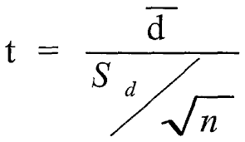
CALCULATION PROCESS OF PAIRED SAMPLE T-TEST :-
Where,
D= Sample mean
S_{d}= Standard Deviation
N= Sample size

Slide 10
-:Paired sample t-test:-
Example:- The sales of a firm for the six months were observed as follows :
MONTH | JAN | FEB | MAR | APR | MAY | JUN
Before adv. | 10 | 11 | 9 | 12 | 8 | 13
After adv. | 11 | 12 | 8 | 10 | 17 | 12
Applying the appropriate test at 10% level , state whether the advertisement had any significant effect on the sales, or not.

Slide 11
-:Solution:-
 | Sales before advt. | Sales after advt. | Difference d | $$d^{2}$$ | (d-$\overline{d}$)²
 | 10 11 9 12 8 13 | 11 12 8 10 17 18 | 1 1 -1 -2 9 5 | 1 1 1 4 81 25 | 1.369 1.369 10.049 17.464 46.649 8.009
Total | N=6 |  | $\sum{d=}$13 | 113 | 84.909
(i) The mean of the differences of the paired value is given by;
$\overline{d}=\frac{\sum{d}}{n}$ = 13/6 = 2.17
(ii) The standard deviation of the differences is given by; Sd = ${\frac{\sqrt{\sum{\left(d−\overline{d}\right)}}}{n_1}}^{2}$=$\frac{\sqrt{84.909}}{5}$=$\sqrt{16.9818}$ = 4.12
Thus, we have ,$\overline{d}$ = 2.17 , Sd= 4.12 , $∝$=0.10 , n= 6, and hence df= 5 (tabular value = 2.015)
Putting the respective values in the model of ‘t’ we get,
t= $\frac{\overline{d}}{s/{√n}}$ = $\frac{2.17×√6}{4.12}$ = $\frac{2.17×2.449}{4.12}$ = $\frac{5.31}{4.12}$ = 1.288

Slide 12
-:One sample t–tests:-
One sample t-tests are used in the following two situations
The size of a sample is less than 25.
The population standard deviation is unknown.
formula : t =$\frac{\overline{x} −µ}{\frac{s}{\sqrt{n}}}$
$\overline{ x}$ = observed mean of sample
µ = assumed mean
s = standard deviation
n = sample size

Slide 13
Example –
The Thomson t.v. company claims that its t.v sets have a mean life of 800 days . A random sample of 10 such sets give the following data :
Life in days | 540 | 600 | 700 | 780 | 720 | 750 | 810 | 840 | 870 | 930
In the light of the above facts, state if the claim of the company is valid at 5% significance level.

Slide 14
Solution- Computation of the mean, and S.D. of the sample
Life in days X | Deviation =X -$\overline{X}$(754) | Square of deviations (X - $\overline{X}$)2
540 | - 214 | 45796
600 | -154 | 23716
700 | - 54 | 2916
780 | 26 | 676
720 | -34 | 1156
750 | -4 | 16
810 | 56 | 3136
840 | 86 | 7396
870 | 116 | 13456
930 | 176 | 30976
Total 7540 | n= 10 | 129240

Slide 15
The mean of the sample is given by $\overline{X}$=$\frac{\sum{X}}{n}$=$\frac{7540}{10}$ = 754
The s.d of the sample is given by S =$\sqrt{\frac{\sum{({X − \overline{X)}}^{2}}}{n −1}}=$
$$\sqrt{\frac{129240}{10−1}}$$
=$\sqrt{14360 }$= 119.83
Thus we have ,
$\overline{X}$= 754 ,S = 119.83, µ = 800, n = 10 , v = n -1 =9, and $∝=0.05$
Let us have, $H_{o}$: $\overline{X}$ = µ and $H_{1}$: $\overline{X}$≠µ
Since the size of the sample is$<30$, the relevant test statistic is given by
t = $\frac{\overline{X }\text{− µ}}{\frac{S}{\sqrt{n}}}$ = $\frac{\text{754 −800}}{\frac{119.83}{\sqrt{10}}}$ = $\frac{46}{37.893}$ = 1.2131
So, the critical value of t for 9 degrees of freedom (i.e. v) at 5% significance level ( $∝=0.05)$ for the t0.05 (9) = 2.626.

Slide 16
-:INDEPENDENT T-TEST:-
The independent t-test is used to find out
the significant difference between means
of 2 different or 2 unrelated group.
It is also called unpaired T-Test.
For example – if we want to find out if
there is any significant difference between
“gender” towards “sales performance”.

Slide 17
-:cALCULATION FORMULA:-
Independent Samples T-Test Formula (Lack of Homogeneity of Variances)
t= $\frac{{\overline{X}}_{1} −{\overline{X}}_{2}}{S} ×\sqrt{\frac{n_{1}×n_{2}}{n_{1}+n_{2}}}$
Where
X̄1 = is mean of first sample,
X̄2 = mean of second sample,
S = Standard deviation,
n1 = the size of the first sample,
n2 = the size of the second sample

Slide 18
-:EXAMPLE:-
The weights of a sample of 7 goats taking peepul leaves were:17,15,20,,18,14,16,and 19 kg. The weights of another sample of 9 goats taking pomegranate leaves were: 18,16,2,19,15,19,22,21,20 kg .
From these data , test the hypothesis at 1% significance level that pomegranate leaves are better than the peepul leaves in improving the weight of goats.

Slide 19
COMPUTATION:-
X₁ |  |  | X₂
17 | 0 | 0 | 18 | -1 | 1
15 | -2 | 4 | 16 | -3 | 9
20 | 3 | 9 | 21 | 2 | 4
18 | 1 | 1 | 19 | 0 | 0
14 | -3 | 9 | 15 | -4 | 16
 |  |  | 19 | 0 | 0
16 | -1 | 1 | 22 | 3 | 9
 |  |  | 21 | 2 | 4
19 | 2 | 4 | 20 | 1 | 1
TOTAL = 119 | n₁ = 7 | 28 | 171 | n₂ = 9 | 44
H0 = There is no significant difference between the two sample means.
H1 = sample mean of peepul leaves is less than sample mean of pomegranate leaves.

Slide 20
The mean of the 1st sample is given by; $\overline{X_{1}}$ =$\frac{\sum{X_{1}}}{n_{1}}$ = $\frac{119}{7}$ = 17
The mean of the 2nd sample is given by; $\overline{X_{2}}$ = $\frac{\sum{X_{2}}}{n_{2}}$ = $\frac{171}{9}$ = 19
The pooled S.D of the two sample is given by;
S=$\sqrt{\frac{\sum{(X_{1 −}\overline{{X1)}^{2}+\sum{(X_{2 −}\overline{{X2)}^{2} }}}}}{n_{1}+n_{2}−2}}$ =$\sqrt{\frac{28+44}{7+9−2}}$ = $\sqrt{\frac{72}{14}}$ = $\sqrt{5.1429}$ = 2.268
Thus we have, $\overline{X_{1}}$= 17, $\overline{X_{2}}$= 19, S=2.268, $∝$= 0.01, $n_{1}$=7, $n_{2}$=9 and df=14.
t= $\frac{{\overline{X}}_{1} −{\overline{X}}_{2}}{S} ×\sqrt{\frac{n_{1}×n_{2}}{n_{1}+n_{2}}}$ = $\frac{17−19}{2.768}×\sqrt{\frac{7×9}{7+9}}$ = 1.75
The critical value of t for v = 14 and α = 0.01 in the one tailed t-test is 2.624 .
The calculated value of t being less than the tabulated value , the null hypothesis is accepted.
That is the pomegranate leaves are not better than peepul leaves in improving the weight of goats.

Slide 21
-:CONCLUSION :-
As we know that T-Test is used to find the significant difference between the means of 2 groups, so we conclude that :
If the calculated T-value is greater than the critical T- value from the table (or the tabulated T-value) , then the difference between the means for two groups is significantly different .

